Slide 1
System Programming
Homework 5

Slide 2
TODOs
Monitor System
Daemonize

Slide 3
Monitor System
TA provide a web-based monitor system. You should use SIGNAL and FIFO to communicate with it.

Slide 4
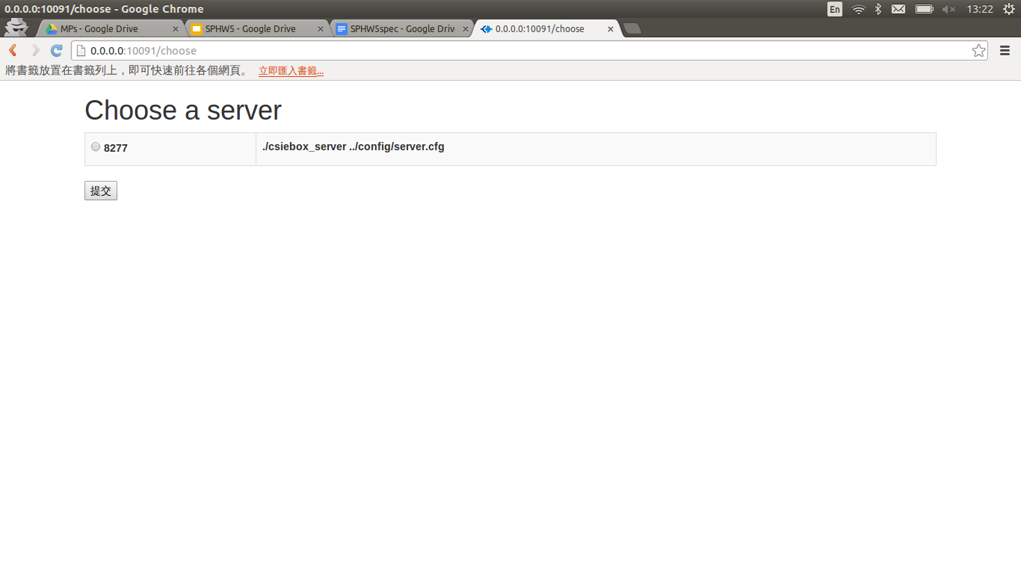
Monitor System

Slide 5
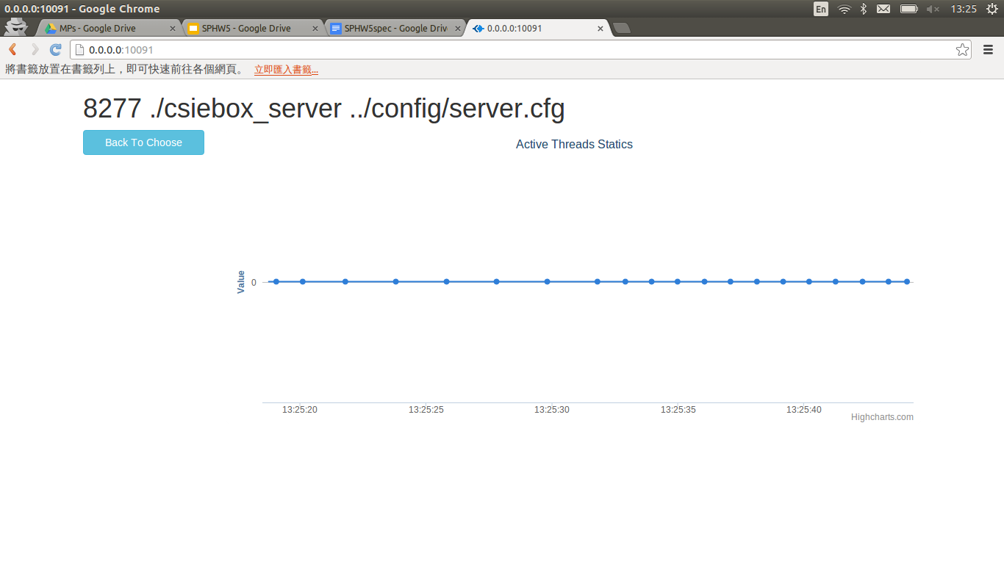
Monitor System

Slide 6
Installation
bash
cd web
./install.sh
restart terminal
cd web
npm start
open browser: http://[server|0.0.0.0]:[PORT]

Slide 7
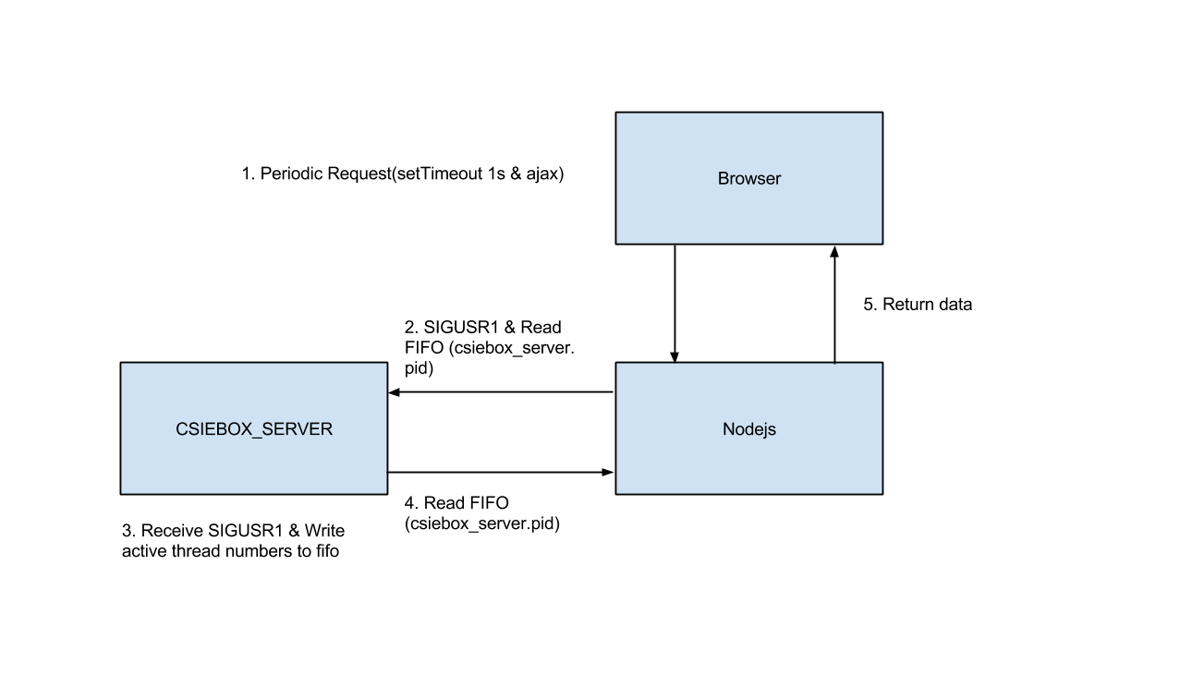

Slide 8
TODOs
Add run_path=/tmp2/b02XXXXXX in server config
Create FIFO after server start, put in run_path with name “csiebox_server.[pid]”
Handle “SIGUSR1” to write thread num
Handle “SIGINT” & “SIGTERM” to clean FIFO

Slide 9
Endian
Byte orders
The web system will accept Big-endian.
Before writing data, use htonl to convert it.
Moreover, please write exactly 4 bytes integer by using uint32_t instead of int

Slide 10
Daemonize
Make csiebox_server daemon.
You can easily find example code to do that by google.
But there are still something to do with the pidfile.

Slide 11
Pidfile
Contain pid of current running process
Use for sending signal to process (stop/monitoring)
Usually put at a well-known directory (default@/tmp2/b02XXXXXX)
Name: “csiebox_server.pid”

Slide 12
Pidfile
However, pid will change during daemonization.
You should maintain this

Slide 13
TODOs
Enable -d argument
./csiebox_server [config] [-d]
Daemonize
Update pidfile
Notice: Create FIFO after daemonize, because of pid change

Slide 14
Due
1/2 18:00

